Slide 1


Mini Project – Semester IV Internal Presentation Part - 1
EMOTION DETECTION
by
Shantanu Gobade Shreya Barai Om Vinchhi
121A3018 121A3010 121A3057
Under the guidance of
Prof. Savita Lohiya
Department of Information Technology
SIES Graduate School of Technology, Nerul

Slide 2
Index
Introduction
Literature survey
Existing system
Methodology
Problem definition
Hardware and software requirements
System Architecture
Applications
Future Scope
Conclusion
References
Project Title

Slide 3
Introduction
Human Emotion Detection is applied in many areas where additional security or data about the person is a big requirement.
Computer Vision serves as a link between computer software and the visuals we see around us.
It enables computer software to comprehend and learn about the visuals in its environment.

Slide 4
Literature Survey
Sr. No | Author | Title & Publication | Key findings/Gap
1 | X. C. F. W. a. J. S. D. Chen | Blessing of Dimensionality: High-Dimensional Feature and Its Efficient Compression for Face Verification, 2013. | Static positioning of face
2 | E. H. G. R. A. L. H. Learned-Miller | " Labeled Faces in the Wild: A Survey," Advances in Face Detection and Facial Image Analysis, 2016. | Finding image similarities are difficult for compute

Slide 5
Literature Survey
Sr. No | Author | Title & Publication | Key findings/Gap
3 | Tengfei Song, Wenming Zheng, Cheng Lu | A Multi-Modal Physiological Emotion Database for Discrete Emotion Recognition, 2019. | High Data-Traffic results in delayed output
4 | Weihong Deng, Jiani Hu | DeepEmo: Real-world Facial Expression Analysis via Deep Learning, 2015. | Less Accuracy

Slide 6
Existing System
Face Detection under Different Lighting.
Difficulty in recognizing hair-like attributes and facial features.
Varying camera angles can hinder the performance.
Current libraries like Dlib and py-face-recognition have comparatively less accuracy.

Slide 7
Methodology
The objective is to create a GUI which can capture the facial expression of the person and based on that calculate, produce the output. The result can be calculated based on real time image.
OpenCV is more accurate
Improved facial recognition.

Slide 8
Problem Definition
Need for advanced & real-time emotion detection.
Machine learning systems and deep learning models make this technology essential.
The presence of data in the form of videos, audios, images.

Slide 9
Hardware & Software Requirement
Hardware
8 GB or above RAM with minimum 2 GB GPU
Intel I5/Ryzen 5
240 GB SSD(Minimum)
In-built Camera
Software
Windows 10 or above OS
Jupyter Notebook
Google Colab
Dropbox

Slide 10
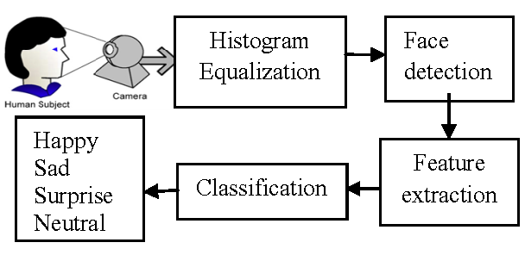
System Architecture

Slide 11
Applications
Safe and personalized cars
Retail Stores
Law enforcement & Monitoring
Surveillance

Slide 12
Future Scope
The future innovation in emotion recognition will allow machines to understand how people feel, which is the first step for them to fulfil our needs.
Speech emotion recognition is a system through which various audio speech files are classified into different emotions such as happy, sad, anger and neutral.

Slide 13
Conclusion
In this project, we emphasize the important role of OpenCV in face detection and emotion recognition. We illustrate the popular algorithms in OpenCV that are used for face detection and emotion recognition.
We assessed & compared recent literature reviews that use OpenCV to detect and recognize the human emotion in a variety of fields in order to improve human life.

Slide 14
References
Kumar N, Bhargava D. A scheme of features fusion for facial expression analysis: A facial action recognition[J]. Journal of Statistics and Management Systems, 2017
Weihong Deng, Jiani Hu, et.al, “DeepEmo: Real-world Facial Expression Analysis via Deep Learning”,IEEE VCIP 2015
Gupta, S. (2018, January). Facial emotion recognition in real-time and static images. IEEE January 2018

Slide 15
References
Balachandran, B., Saad, K. F., Patel, K., & Mekhiel. Parallel Computer for Face Recognition Using Artificial Intelligence. IEEE December 2019
Khan, M., Chakraborty, S., Astya, R., & Khepra, S. (2019, October). Face Detection and Recognition Using OpenCV. In 2019 International Conference on Computing, Communication, and Intelligent Systems (ICCCIS) (pp. 116-119). IEEE

Slide 16
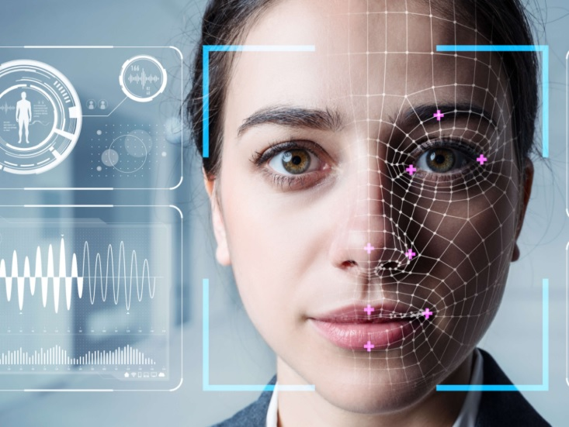
Thank You!

